Slide 1
Firebase Hosting
Signup, login, logout

Slide 2
Firebase deploying from command prompt/terminal
Command 1: Firebase login
Command 2: Firebase init
Go to the public folder that is created and add your assignment files here.
Command 3: Firebase deploy

Slide 3
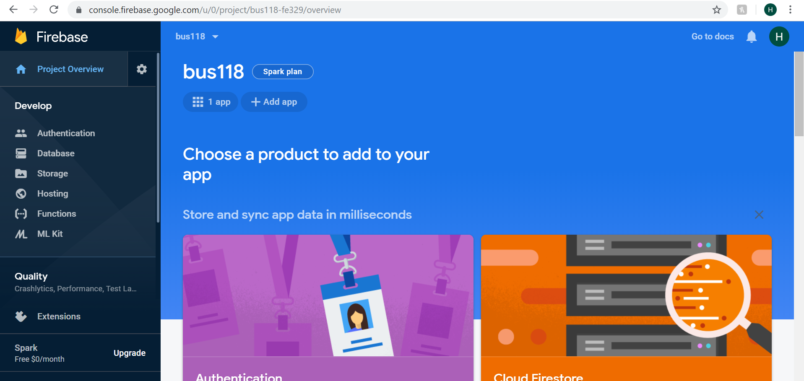
How does firebase know which app to host?

Slide 4
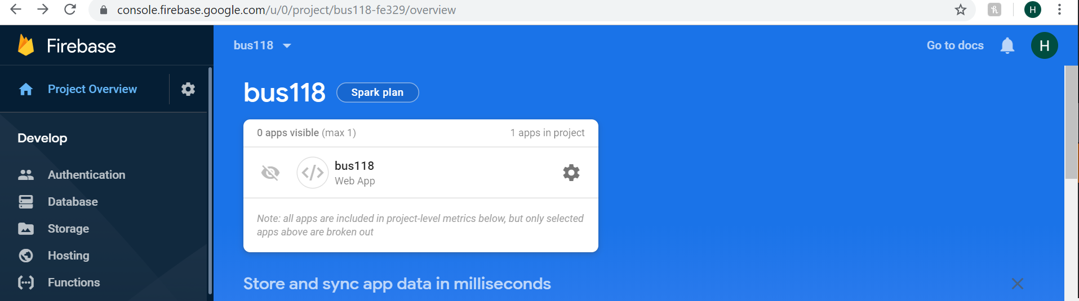
Click on 1 app
Click on the settings icon

Slide 5
Scroll down
Copy the code and paste it at the end of the body tag in index.html code
Example:
<!-- The core Firebase JS SDK is always required and must be listed first --> <script src="https://www.gstatic.com/firebasejs/7.2.1/firebase-app.js"></script> <!-- TODO: Add SDKs for Firebase products that you want to use https://firebase.google.com/docs/web/setup#available-libraries --> <script> // Your web app's Firebase configuration var firebaseConfig = { }; // Initialize Firebase firebase.initializeApp(firebaseConfig); </script>

Slide 6
In index.html for the reference of firebase database and authentication
Add the two following scripts along with the code from the previous slide:
<script src="https://www.gstatic.com/firebasejs/6.1.1/firebase-auth.js"></script>
<script src="https://www.gstatic.com/firebasejs/6.1.1/firebase-database.js"></script>

Slide 7
In index.html
Add the id for every div tag so that it is easy to take the values
Code in the body tag:
<div id="login_div" class="main-div" style="display:block">
<h3>Firebase Web login Example</h3>
<input type="email" placeholder="Email..." id="email_field" />
<input type="password" placeholder="Password..." id="password_field" />
<div></div>
<button onclick="login()">Login to Account</button><br>
<button onclick="signup()">Sign up Account</button>
</div>

Slide 8
In index.html
New code for signout functionality is to be added:
Code:
<div id="user_div" class="loggedin-div" style="display:none">
<h3>Welcome User</h3>
<p id="user_para">Welcome to Firebase web login Example. You're currently logged in.</p>
<button onclick="logout()">Logout</button>
</div>

Slide 9
Include the index.js
Donot forget to include the index.js file at the end of the html file, before the end of the body tag:
<script src="index.js"></script>

Slide 10
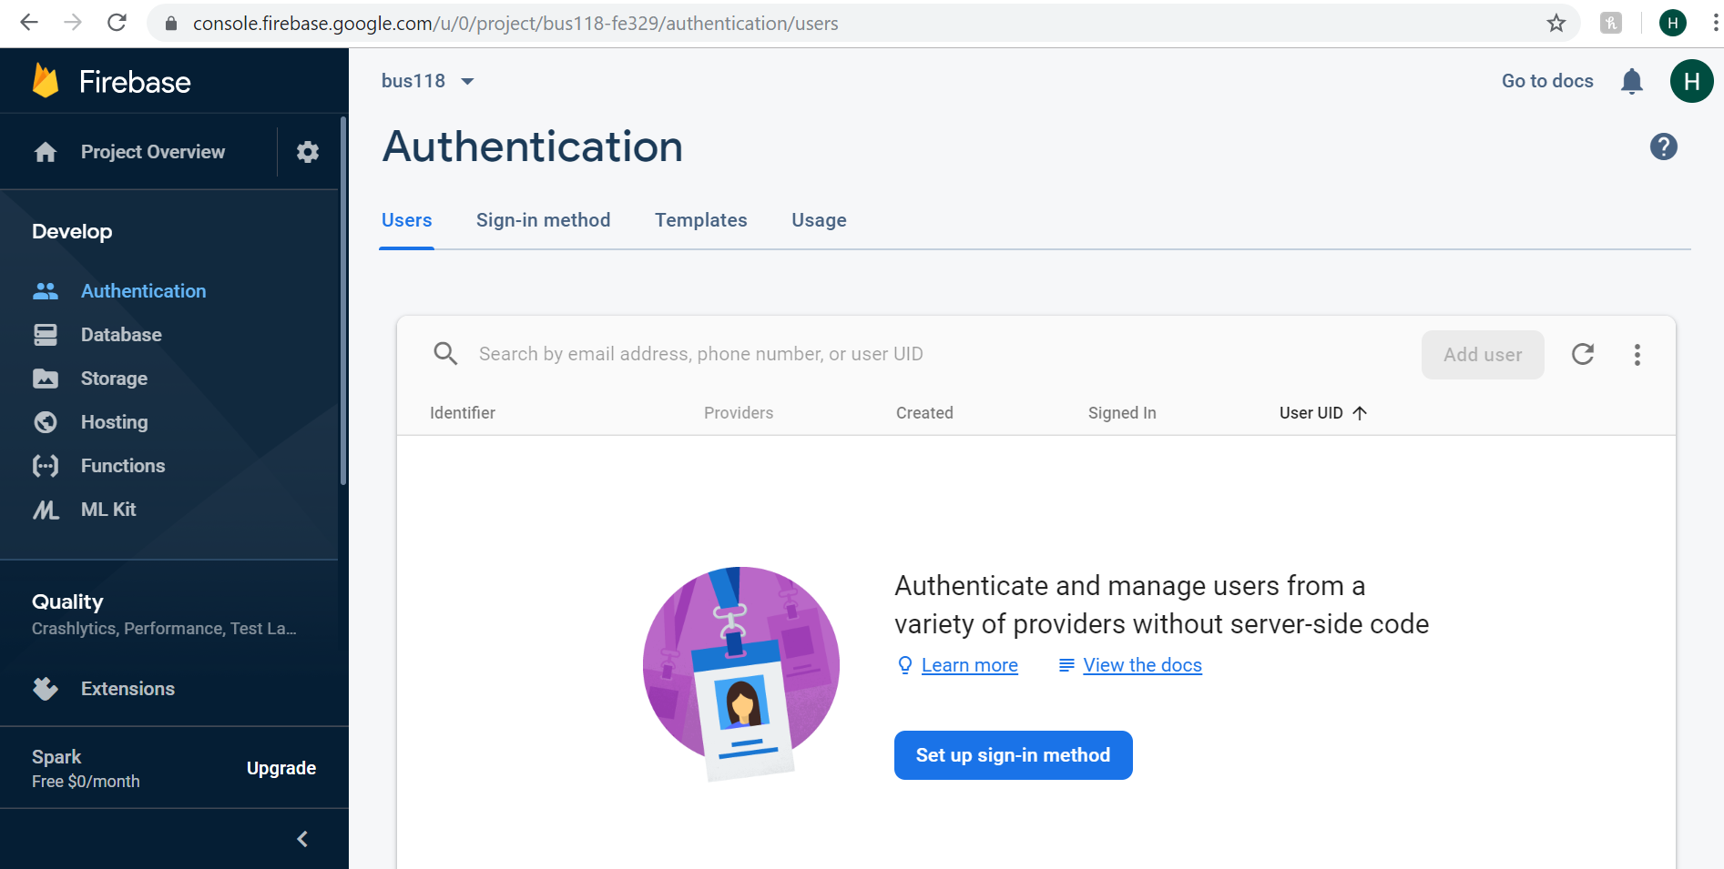
Creating users

Slide 11
Method to create the users
Database -> docs -> Get started with web
Authentication ->Web->Manage Users
Let us get to know how to use the method “createUserWithEmailAndPassword”
Code given in firebase:
firebase.auth().createUserWithEmailAndPassword(email, password).catch(function(error) {
// Handle Errors here.
var errorCode = error.code;
var errorMessage = error.message;
// ...
});

Slide 12
Signup Complete Code
Signup, login, logout

Slide 13
function signup(){ var userEmail = document.getElementById("email_field").value;
var userPass = document.getElementById("password_field").value; firebase.auth().createUserWithEmailAndPassword(userEmail, userPass).then(function(user)
{
// user signed up success
if (user) {
document.getElementById("user_div").style.display = "block";
document.getElementById("login_div").style.display = "none"; var user = firebase.auth().currentUser; if(user != null){ var email_id = user.email;
document.getElementById("user_para").innerHTML = "New User Created : " + email_id; }
}
}).catch(function(error) {
// Handle Errors here.
var errorCode = error.code;
var errorMessage = error.message; window.alert("Error : " + errorMessage); // ...
});
}

Slide 14
SignIn Code and Explanation
In same document mentioned in the previous slide:
Path : https://firebase.google.com/docs/auth/web/password-auth?authuser=0#create_a_password-based_account
Let us understand the sign in method “signInWithEmailAndPassword”
Code given in firebase:
firebase.auth().signInWithEmailAndPassword(email, password).catch(function(error) {
// Handle Errors here.
var errorCode = error.code;
var errorMessage = error.message;
// ...
});

Slide 15
SignIn Complete Code
Signup, login, logout

Slide 16
function login(){
var userEmail = document.getElementById("email_field").value;
var userPass = document.getElementById("password_field").value; firebase.auth().signInWithEmailAndPassword(userEmail, userPass).then(function(user) {
// user signed in
if (user) {
document.getElementById("user_div").style.display = "block";
document.getElementById("login_div").style.display = "none"; var user = firebase.auth().currentUser; if(user != null){ var email_id = user.email;
document.getElementById("user_para").innerHTML = "Welcome User : " + email_id; }
}
}).catch(function(error) {
// Handle Errors here.
var errorCode = error.code;
var errorMessage = error.message; window.alert("Error : " + errorMessage); // ...
});
}

Slide 17
Signout Complete Code
Signup, login, logout

Slide 18
Signout code and Explanation:
To sign out a user, call signOut:
Code:
firebase.auth().signOut().then(function() {
// Sign-out successful.
}).catch(function(error) {
// An error happened.
});

Slide 19
function logout(){
firebase.auth().signOut();
document.getElementById("user_div").style.display = "none";
document.getElementById("login_div").style.display = "block";
}

Slide 20
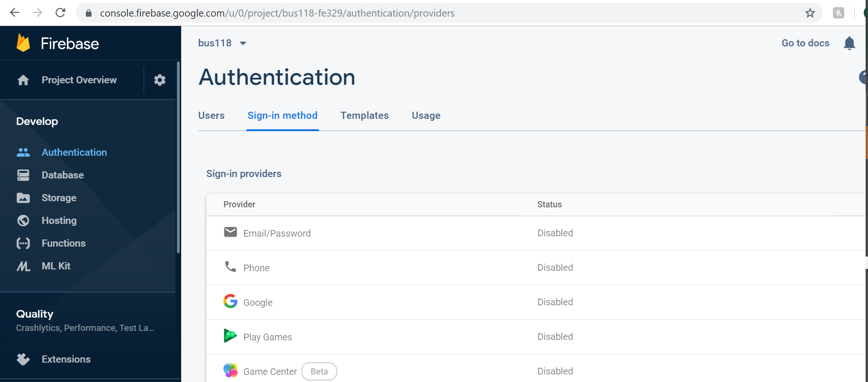
Enable Email and Password Authentication

